Slide 1
A Tradition of Excellence!

Slide 2
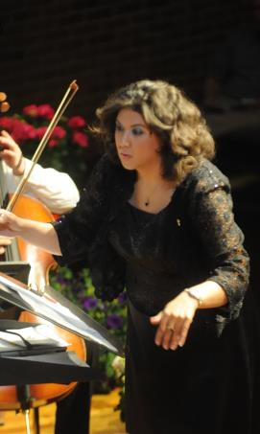
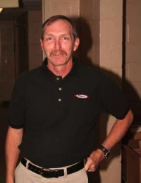
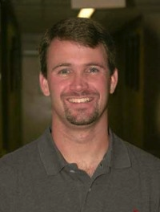
Staff
Rachel Seibel
Front Ensemble Instructor
Mikayla Rodski
Front Ensemble Instructor
Dave Fisher
Assistant Band Director
Tom Vail
Marching Instructor
Brian Foltz
Battery Instructor
Christine Metzger
Color Guard Instructor
Samantha Pickett
Color Guard Instructor
Nate Fuerst
Battery Instructor
Brandi Jason
Instrumental Music Director
Katie Greco
Color Guard Instructor

Slide 3
Mission & Purpose
Create a superior product through mastery of skill, pedagogy, musicianship and the development of creative appropriate style.
Transform students into literate consumers of music from all style periods, cultures and genres, with an aesthetic appreciation for the fine arts.
Build confident, responsible citizens who provide musical service to the school and greater community.
Build relationships in a safe, family-oriented environment that supports individual creativity with opportunities for personal growth.

Slide 4
Tournament of Bands (TOB)
A competitive circuit with an educational philosophy rooted in precision, mastery and execution of skill.
Closely resembles DCA and DCI competitive (“professional”) drum corps.
Limited to the U.S. Atlantic Coast with most participants active between the Carolinas and upstate New York.
One regional (multi-state) “chapter championship” in October followed by Atlantic Coast Championships at Hershey Stadium in November.

Slide 5
Competitive Marching Band
Creative, original shows that are thought provoking and highly visual. We hire a team of professionals to write our winds arrangement, percussion arrangement, and drill design. Nothing is “purchased” from a store. It is 100% LHS owned and written.
Our shows are “organically” written: every student participates 100% of the time with music and drill written for each individual. This is why a contractual agreement and outstanding attendance is required.
A simple concept expanded/transformed to include original music, drill design, guard routine, guard costuming, integrated guard equipment and props. (i.e. bird, composing, bricks, forest)
A “musical” performed on a football field in 7 minutes and 30 seconds.

Slide 6
Who are we looking for?
Enthusiastic, outgoing students who think outside the box and challenge themselves in new, creative ways.
Confident, go-getters who are eager to perform and push the boundaries of their musicianship.
Students who have a friendly attitude and an outstanding spirit of teamwork and cooperation.
Students who are committed, driven, disciplined, and persevere through setbacks.
Students who are reasonably athletic and will commit to a healthy lifestyle that will keep them active throughout the season.

Slide 7
The 2020 Season
3-week Summer Band Camp (August 3- August 21)- mandatory
2-week post Summer Band Camp
In-school Season (Attendance Policy in place)
Full Band Rehearsals Tuesdays and Thursdays 6-9 pm
Sectionals:
Monday- Color Guard, 5-8 pm
Wednesday- Horn Line, 2:30-5 pm
Wednesday- Percussion, 6-9 pm

Slide 8
The 2020 Season
Home Games (scheduled Fridays)
Competitions (scheduled Saturdays)
Chapter V (Greater MD) Championships on October 24
Atlantic Coast Championships
Sunday November 8
Post Season Field Trip to ORMS (November or December)

Slide 9
The 2020 Season
We have a 9-4 pm rehearsal on the following dates: Saturday 9/12 and 9/19, Friday 10/16 and Saturday 11/7.
Some weeknight schedules are altered due to Jewish holidays and national elections.

Slide 10
Attendance is Mandatory
Absences for Summer Band Camp must be pre-approved by Ms. Jason. Please make every effort to re-work vacation plans and appointments around the camp schedule.
Students are expected to be transparent with all known absences before signing a contract.
5 missed rehearsals attendance policy in effect starting the first day of school.
It is extremely rare for a student to miss a scheduled competition.
No student may miss Chapter V Championships or Atlantic Coast Championships.

Slide 11
The only person who can fill your student’s spot…is YOUR student.
We do not have alternates.
We cannot “bench” students in our activity.
When your student is absent we march “a hole” on the field.
When your student is absent no one plays their instrument or spins their equipment.
When your student missed rehearsal the group suffers and cannot move forward.
When a student is absent for a performance…we lose points.

Slide 12
MB Procedures Handout
Week 1: | 8/3- 8/7 | Horn Line/Battery M/W/F, 9-4 pm T/Thurs, 9-12 noon; 6-9 | Front Ensemble/Color Guard M-Thurs. 9-12 noon; 6-9pm Friday, 9-4 pm
Week 2: | 8/10- 8/14 | M/W/F, 9-4 pm T/Thurs, 9-12 noon; 6-9 | M-Thurs. 9-12 noon; 6-9 pm Friday, 9-4 pm
Week 3: | 8/17- 8/21 | M/W, 9-4 pm T/Thurs, 9-12 noon; 6-9 Friday, 9-9 pm* | M- Thursday, 9-12 noon; 6-9 pm Friday, 9-9 pm*

Slide 13
Please See Calendar Document Titled 2020 MB Calendar
Due to the COVID-19 pandemic, the rehearsals, sectionals, football games and competitions listed are subject to change or cancellation.
This schedule best represents how the Lions’ Pride Marching Band would operate under NORMAL conditions.

Slide 14
Marching Band Fees (MB Fees Document)
The overall cost for marching band is upwards of $50,000.
Students pay for personal equipment and uniform needs which can vary greatly between sections.
Food and transportation fees help offset costs to the Boosters by covering a small percentage of the overall bill.
Flexible payment plans. Ask Ms. Jason.
2020 show shirts and spirit wear are optional.

Slide 15
Due to the COVID-19 Pandemic
The prices listed on the 2020 Marching Band Fees document reflect a typical competition season at Liberty High School; they do not include modifications that may need to be made due to the COVID-19 pandemic and/or restrictions placed on CCPS school activities.
Prices would be LOWERED if the season were modified to exhibition (only) performances, etc. Therefore, prices are subject to change reflecting the modifications we may encounter as a school system.
We are hoping that a decision will be reached by August 1, 2020 regarding extracurricular activities/fall sports, which will help us to have a better understanding of how we will proceed for our 2020 Liberty Lions’ Pride Marching Band season.

Slide 16
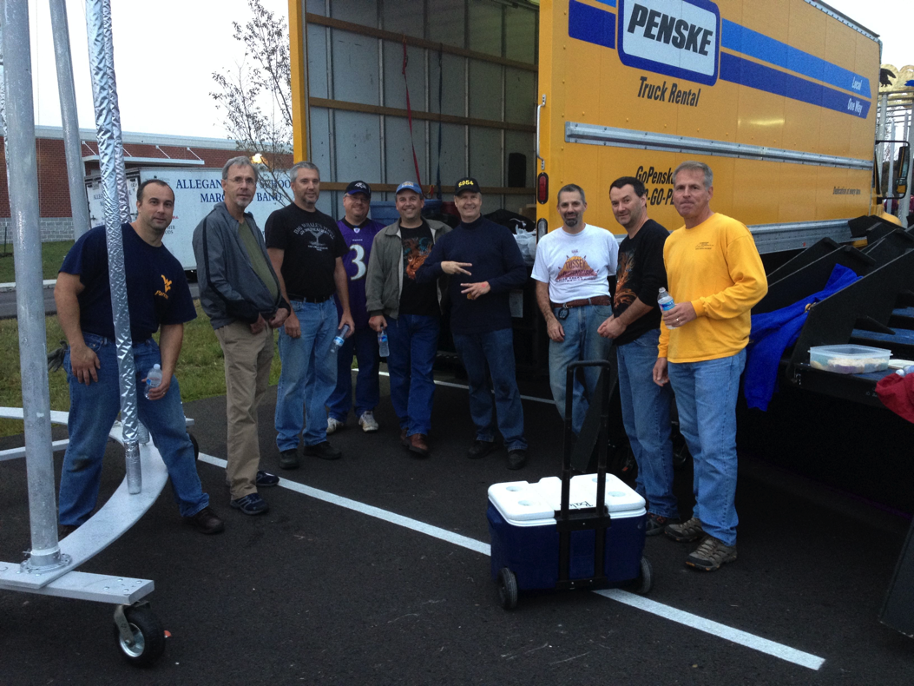
LHS Instrumental Music Boosters
We raise money to help with:
Instruments & instrument repair
Sheet music
Food & field trips
Transportation
We support the Music Program!
Volunteers
Pit & props
Chaperones
We are FANS!

Slide 17
Join a Championship Team!
Ms. Brandi Jason
LHS Instrumental Music
bdjason@carrollk12.org
LHSIMP Web Site!
www.LHSIMP.com

