Slide 1

An Enduring Tradition of Excellence!

Slide 2
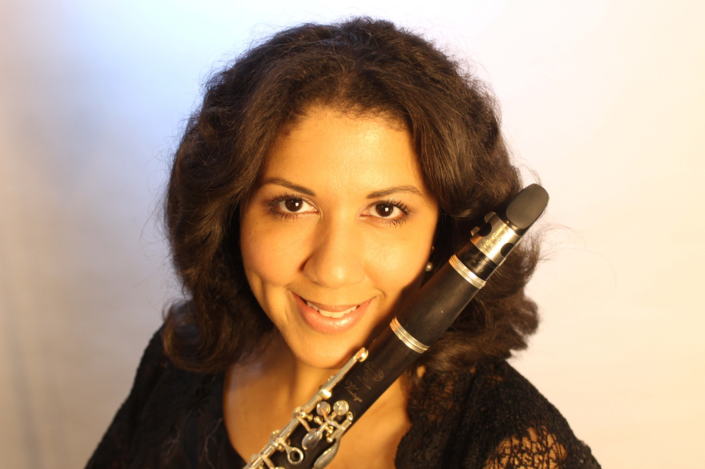
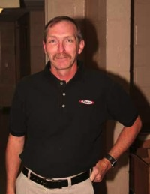

Band Directors
Brandi Jason
Instrumental Music Director
David Fisher
Assistant Band Director

Slide 3
Band Staff
Percussion Staff
Color Guard Staff
Mikayla Rodski, Front Ensemble
Amy DeLoriea, Front Ensemble
Ian Hingley, Front Ensemble Technician
Mark Gabriele, Battery
Mike Mora, Battery
Sara McDougall, Instructor
Aryn Kestel, Instructor
Katelyn Payne, Instructor

Slide 4
Band Staff
Marching Staff w/ Dave Fisher
Music Staff w/ Brandi Jason
Thomas Vail
Christopher Hettenbach

Slide 5
Mission & Purpose
Create a superior product through mastery of skill, pedagogy, musicianship and the development of creative appropriate style.
Transform students into literate consumers of music from all style periods, cultures and genres, with an aesthetic appreciation for the fine arts.
Build confident, responsible citizens who provide musical service to the school and greater community.
Build relationships in a safe, family-oriented environment that supports individual creativity with opportunities for personal growth.

Slide 6
Tournament of Bands (TOB) &
Cavalcade of Bands
Competitive circuits with an educational philosophy rooted in precision, mastery and execution of skill.
Closely resembles DCA and DCI competitive (“professional”) drum corps.
Limited to the U.S. Atlantic Coast with most participants active between the West Virginia and upstate New York.
One regional (multi-state) “chapter championship” for TOB in October followed by Atlantic Coast Championships at Hershey Stadium in November. Cavalcade Championship at New Oxford High School in PA.

Slide 7
Competitive Marching Band
Creative, original shows that are thought provoking and highly visual. We hire a team of professionals to write our winds arrangement, percussion arrangement, and drill design. Nothing is “purchased” from a store. It is 100% LHS owned and written.
Our shows are “organically” written: every student participates 100% of the time with music and drill written with each individual. This is why a contractual agreement and outstanding attendance is required.
A simple concept expanded/transformed to include original music, drill design, guard routine, guard costuming, integrated guard equipment and props. (i.e. bird, Arabia, dolls, bricks, forest)
A “musical” performed on a football field in 7 minutes and 30 seconds.

Slide 8
Who are we looking for?
Enthusiastic, outgoing students who think outside the box and challenge themselves in new, creative ways.
Confident, go-getters who are eager to perform and push the boundaries of their musicianship.
Students who have a friendly attitude an outstanding spirit of teamwork and cooperation.
Students who are committed, driven, disciplined, and persevere through setbacks.
Students who are reasonably athletic and will commit to a healthy lifestyle that will keep them active throughout the season.

Slide 9
The 2025 Season
May “mini band camp” (May 21, 22 and 23 )
3-week Summer Band Camp (August 4- August 22)- mandatory
1-week post Summer Band Camp
In-school Season (Attendance Policy in place)
    Full Band Rehearsals Tuesdays and Thursdays 6-9 pm
    Sectionals:
    Monday- Color Guard, 6-9 pm
    Wednesday- Horn Line, 2:30-5:00 pm
    Wednesday- Percussion, 6-9 pm

Slide 10
The 2025 Season
Home Games (scheduled Fridays)
Competitions (scheduled Saturdays)
TOB Chapter V (Greater MD) Championships on October 18
TOB Atlantic Coast Championships on November 1 or 2
Post Season Field Trip to ORMS (November)

Slide 11
Summer Full Band Rehearsals
Wednesday, June 11, 6-9 pm
Wednesday, July 9, 6-9 pm
Wednesday, July 23, 6-9 pm
*Mandatory for those in town and available.

Slide 12
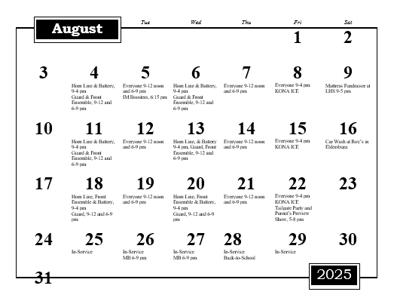
MB Calendar

Slide 13
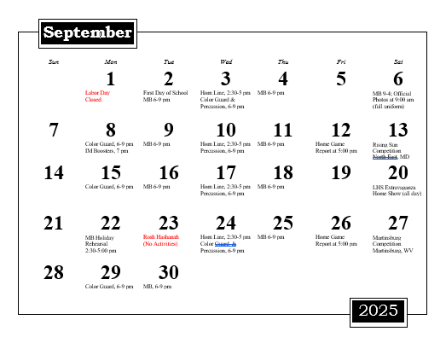
MB Calendar

Slide 14
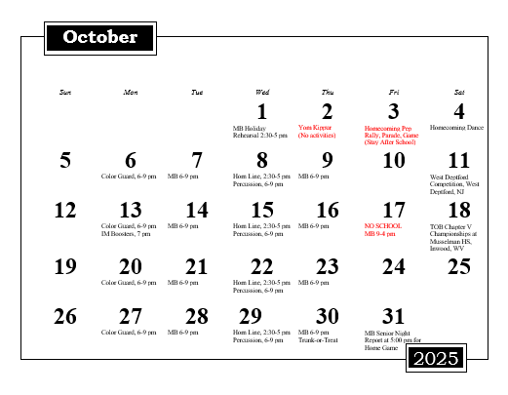
MB Calendar

Slide 15
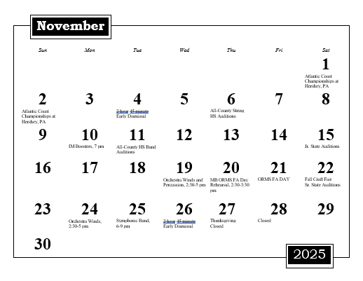
MB Calendar

Slide 16
Attendance is Mandatory
Absences for Summer Band Camp must be pre-approved by Ms. Jason. Please make every effort to re-work vacation plans and appointments around the camp schedule.
Students are expected to be transparent with all known absences before signing a contract.
5 missed rehearsals attendance policy in effect starting the first day of school.
It is extremely rare for a student to miss a scheduled competition.
No student may miss Chapter V Championships, Cavalcade Championshps or Atlantic Coast Championships.

Slide 17
The only person who can fill your student’s spot…is YOUR student.
We do not have alternates.
We cannot “bench” students in our activity.
When your student is absent we march “a whole” on the field.
When your student is absent no one plays his/her instrument or spins his/her equipment.
When your student missed rehearsal the group suffers and cannot move forward.
When a student is absent for a performance…we lose points.

Slide 18
Band Fees
Students only pay for personal equipment and uniform needs which can vary greatly between sections.
Food and transportation fees help offset costs to the Boosters by covering a small percentage of the overall bill.
Flexible payment plans.
2025 show shirts and Boosters membership are optional.

Slide 19

2025 Band Fees
See Band Fees Document which also has the QR code leading you to our registration site.

Slide 20
Guard/DM Uniform and Flags

Slide 21
Band Uniform

Slide 22
Registration due June 2, 2025
Register Online at the bottom of the Marching Band fees sheet using the link below or the QR code:

Slide 23
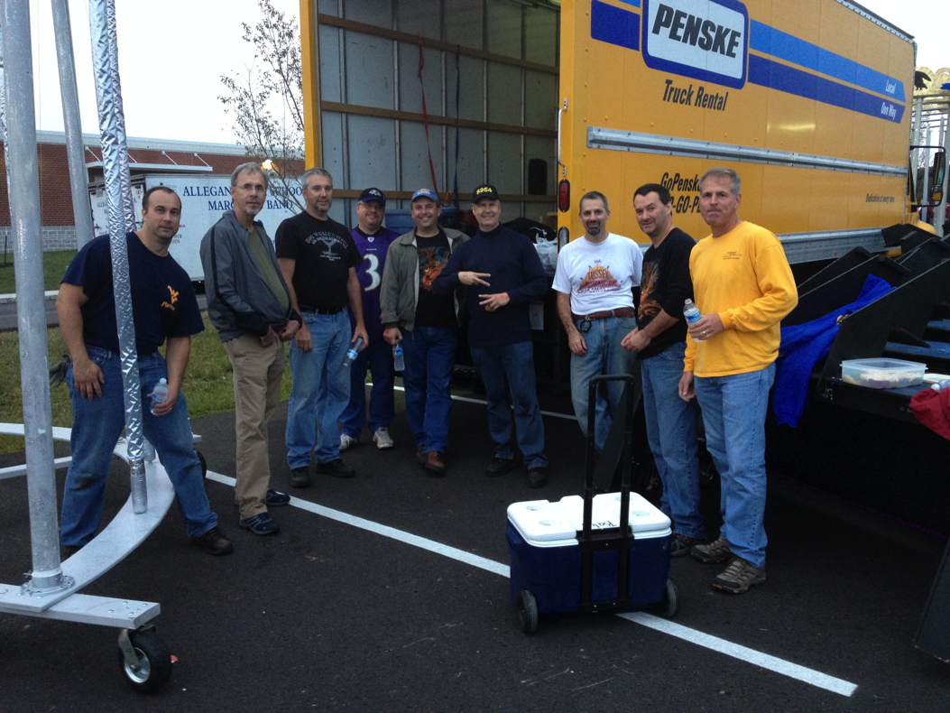
LHS Instrumental Music Boosters
We raise money to help with:
  Instruments & instrument repair
  Sheet music
  Food & field trips
  Transportation
We support the Music Program!
  Volunteers
  Pit & props
  Chaperones
We are FANS!

Slide 24

Join a Championship Team!
Ms. Brandi Jason
  LHS Instrumental Music
  bdjason@carrollk12.org
LHSIMP Web Site!
  www.LHSIMP.com

